Slide 1
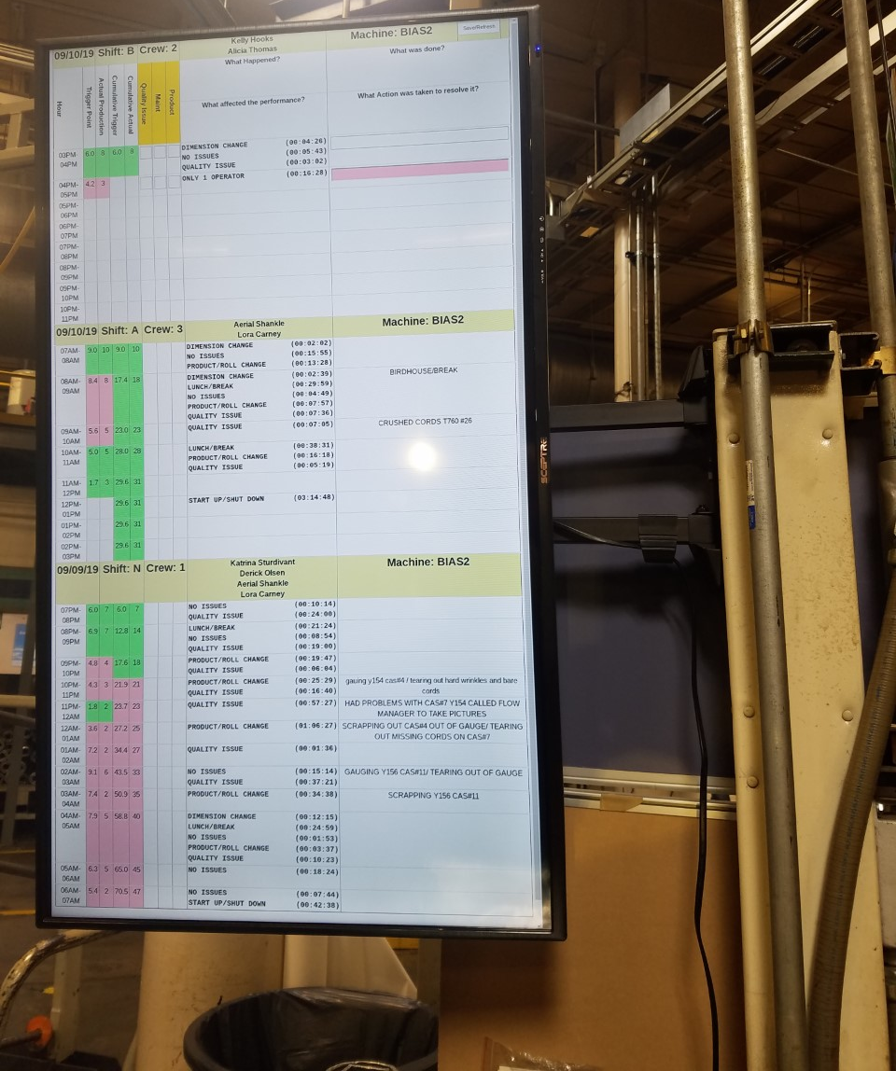
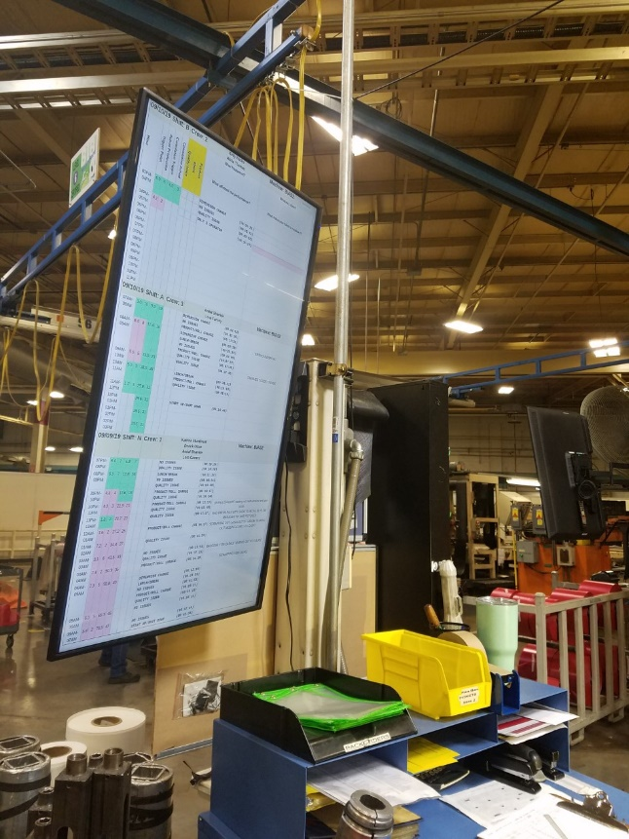
DIGITAL HRxHR
Chart

Slide 2
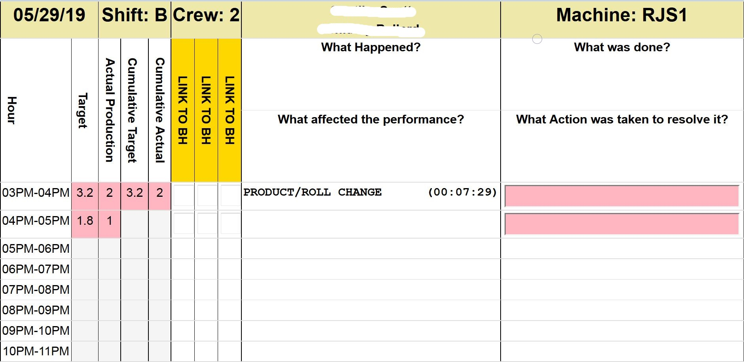
SOFTWARE
SHIFT SCHEDULE - Works with shifts of any length shift
An HRxHR is generated for each machine in system.
LDAP - Provides names
SQL Database - Supplies downtime
Comments are manually entered for red hrs
Production and TPUs from production tracking system
Notes:
<number>

Slide 3
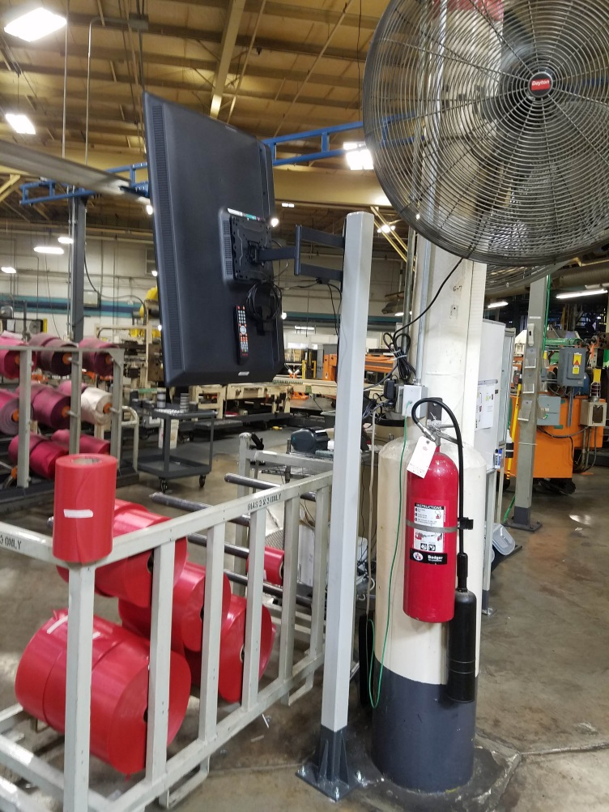
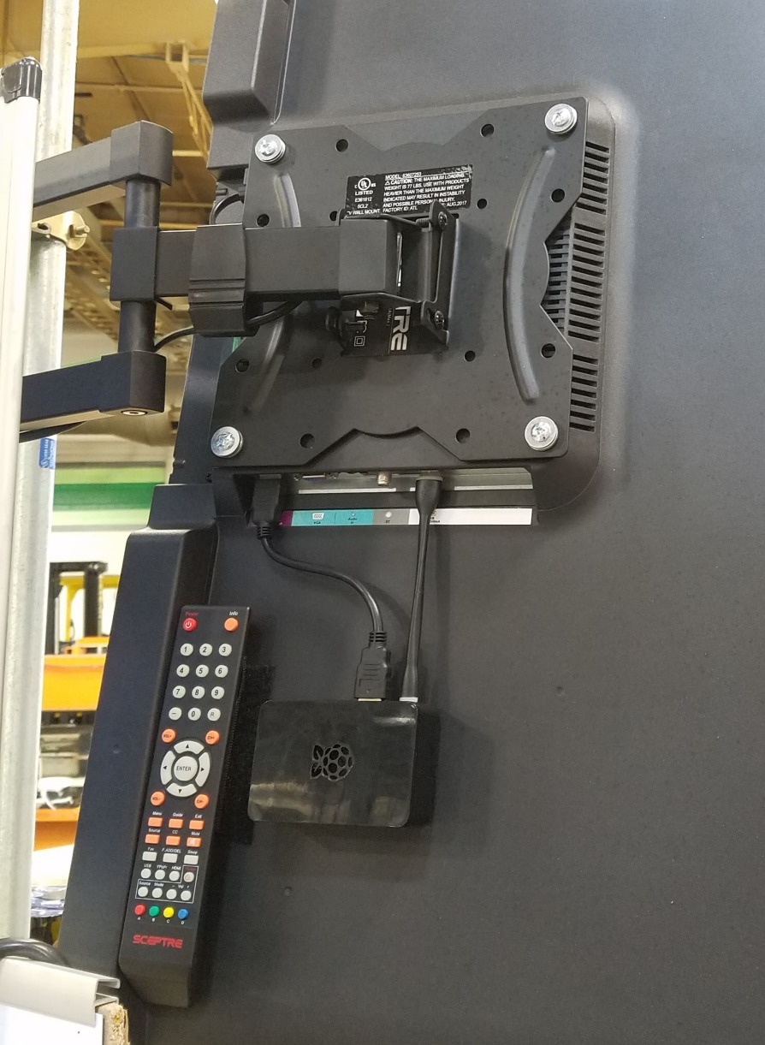
HARDWARE
43” 1080p TV: $150
Raspberry Pi (mini computer): $55
Wall Mount: $27
HDMI Cable: $7
Memory Card: $8
Total Cost: $247 for 1 digital HRxHR
WIFI
COMPUTER

Slide 4
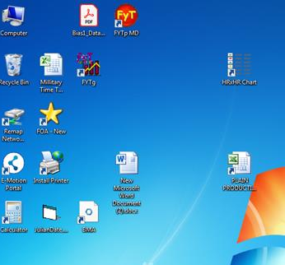
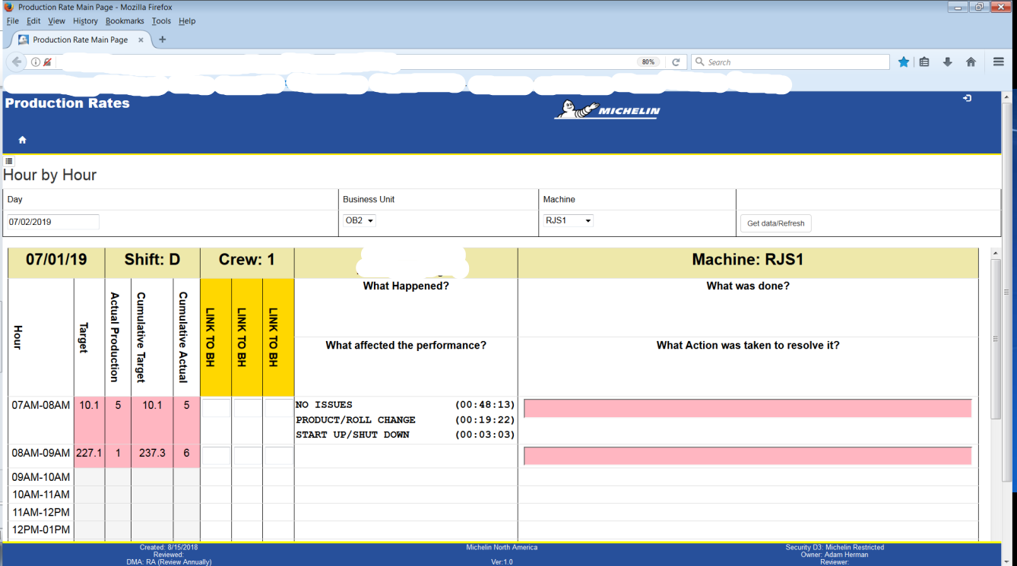
DESKTOP LINK
Operators click a link on their PC to fill out comments for red hours.
Desktop Link
There is a separate website for the manager to view all HRxHRs online.

Slide 5
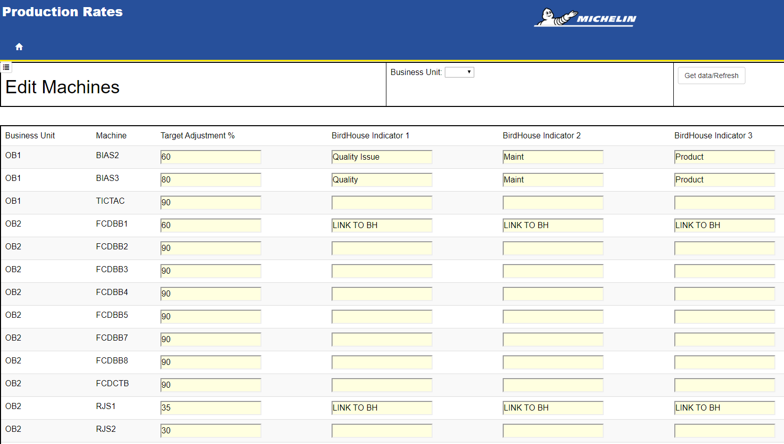
DESKTOP LINK
Adjustable Trigger Point
Customize Birdhouse Links
Export to Excel

Slide 6

BENEFITS
TRIGGER POINTS BASED ON THE TPU – The paper HRxHR is green when producing fast products and red when producing slow products.
ADJUSTABLE TRIGGER POINT (% OF TRS)
REDUCED DATA ENTRY - $2,266/yr savings.
VISIBILITY OF OEE DATA – See what OEE downtime the operator is selecting.
SAVE THE DATA
VIEW FROM THE WEB
SAVE FLOOR SPACE
NO SPECIALIZED HARDWARE OR SOFTWARE

Slide 7

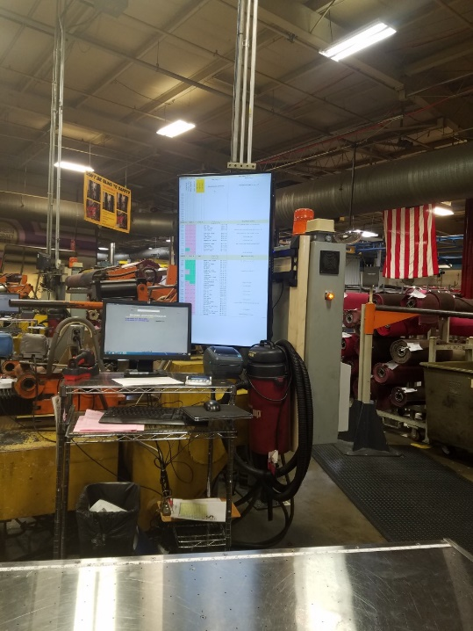
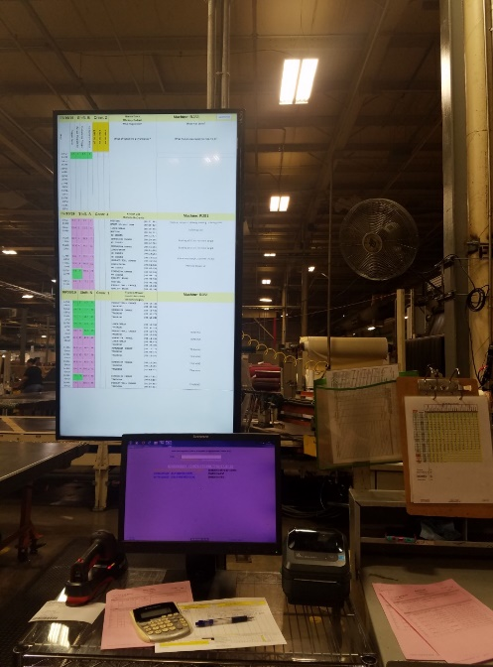
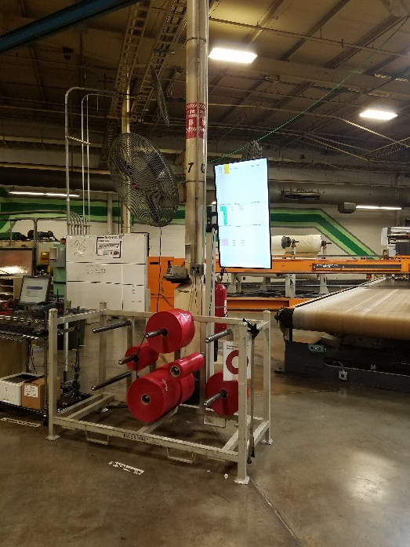
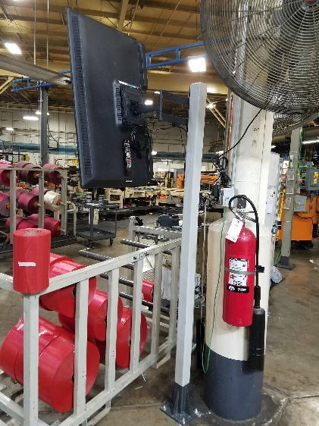
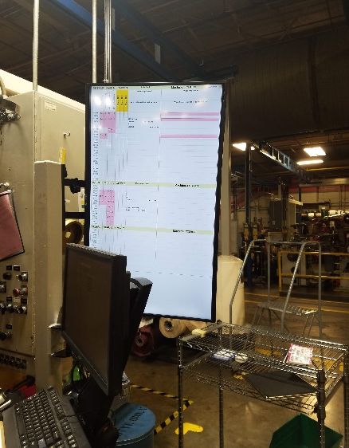
THANK YOU

